Slide 1




























Lenz’s Law
An induced electromotive force ξ generates a current that induces a counter magnetic field that opposes the change in magnetic field generating the current.
http://www.micro.magnet.fsu.edu/electrom
ag/java/lenzlaw/index.html
An induced emf drives current around a circuit just as the emf of a battery does.
With a battery, conventional current is directed out of the positive terminal, through the attached device, and into the negative terminal.
The same is true for an induced emf, but the location of the positive and negative terminals is not as obvious.

Slide 2




























To determine the location of the positive and negative terminals (i.e., the direction of current), it is important to remember that there are two magnetic fields in these situations:
The original magnetic field, and
The induced magnetic field created by the induced current.
Lenz’s Law: polarity from the induced emf is found first by knowing…
The induced magnetic field opposes the original flux
change
Using the RHR#2: if fingers point in direction of induced magnetic field in coil, then thumb points in direction of induced current.
Current flows from positive to negative in any circuit.

Slide 3

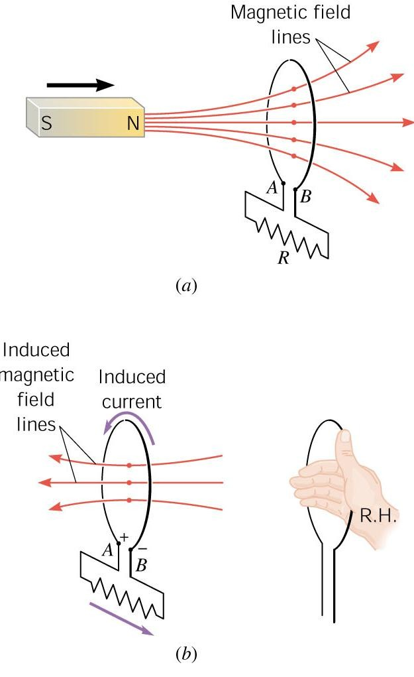








EMF
produced by a moving magnet:
The induced magnetic field opposes the original flux
change
Using the RHR#2: if fingers point in direction of induced magnetic field in coil, then thumb points in direction of induced current.
Current flows from positive to negative in any circuit.

